Slide 1

Information Technology 2
HE3001, Microeconomics 3 Nanyang Technological University

Slide 2
A Model of Two sided markets

Slide 3
Two-sided markets
Two distinct groups from different markets.
Last week: Console Seller market, Game Seller market
Also: Credit card users, Merchants
More users in one market leads to higher value in the other market.
Usually, a single platform/meeting place for consumers of these two groups creates largest benefits
Note: a bit different from complementarities where utility is independent of what others do.
More about two goods working together to increase one’s utility.

Slide 4
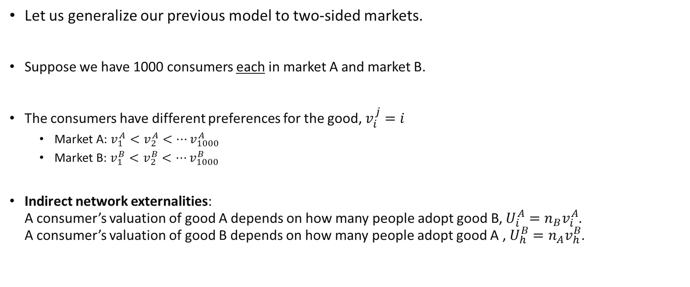
Two-sided markets
Let us generalize our previous model to two-sided markets.
Suppose we have 1000 consumers each in market A and market B.
The consumers have different preferences for the good, $v_{i}^{j}=i$
Market A: $v_{1}^{A}<v_{2}^{A}<…v_{1000}^{A}$
Market B: $v_{1}^{B}<v_{2}^{B}<…v_{1000}^{B}$
Indirect network externalities: A consumer’s valuation of good A depends on how many people adopt good B, $U_{i}^{A}=n_{B}v_{i}^{A}$. A consumer’s valuation of good B depends on how many people adopt good A , $U_{h}^{B}=n_{A}v_{h}^{B}$.

Slide 5
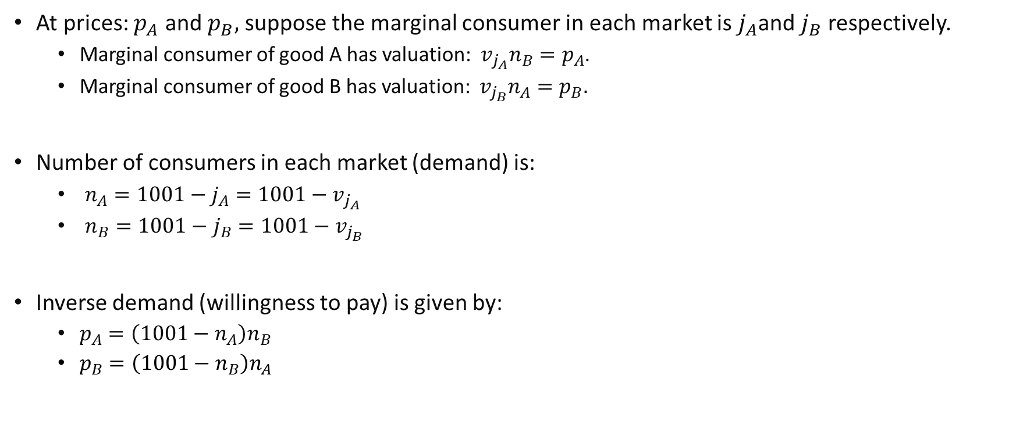
Two-sided markets
At prices: $p_{A}$ and $p_{B},$ suppose the marginal consumer in each market is $j_{A}$and $j_{B}$ respectively.
Marginal consumer of good A has valuation: $v_{j_{A}}n_{B}=p_{A}$.
Marginal consumer of good B has valuation: $v_{j_{B}}n_{A}=p_{B}.$
Number of consumers in each market (demand) is:
$n_{A}=1001−j_{A}=1001−v_{j_{A}}$
$n_{B}=1001−j_{B}=1001−v_{j_{B}}$
Inverse demand (willingness to pay) is given by:
$p_{A}=\left(1001−n_{A}\right)n_{B}$
$p_{B}=\left(1001−n_{B}\right)n_{A}$

Slide 6

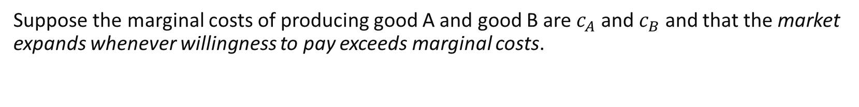



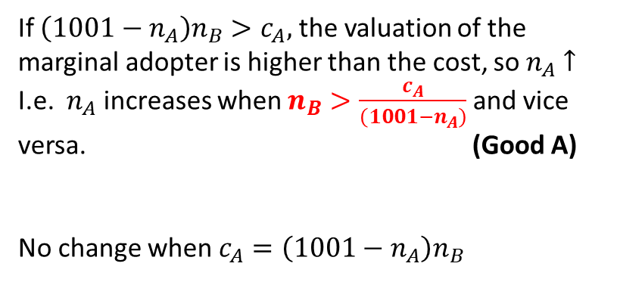

Two-sided markets
Suppose the marginal costs of producing good A and good B are $c_{A}$ and $c_{B}$ and that the market expands whenever willingness to pay exceeds marginal costs.
$$n_{B}=\frac{c_{A}}{\left(1001−n_{A}\right)}$$
$$n_{B}$$
If $\left(1001−n_{A}\right)n_{B}>c_{A},$ the valuation of the marginal adopter is higher than the cost, so $n_{A}$ $↑$
I.e. $n_{A}$ increases when $n_{B}>\frac{c_{A}}{\left(1001−n_{A}\right)}$ and vice versa. (Good A)
No change when $c_{A}=\left(1001−n_{A}\right)n_{B}$
$$n_{B}>\frac{c_{A}}{\left(1001−n_{A}\right)}$$
$$n_{B}<\frac{c_{A}}{\left(1001−n_{A}\right)}$$
$$n_{A}$$

Slide 7

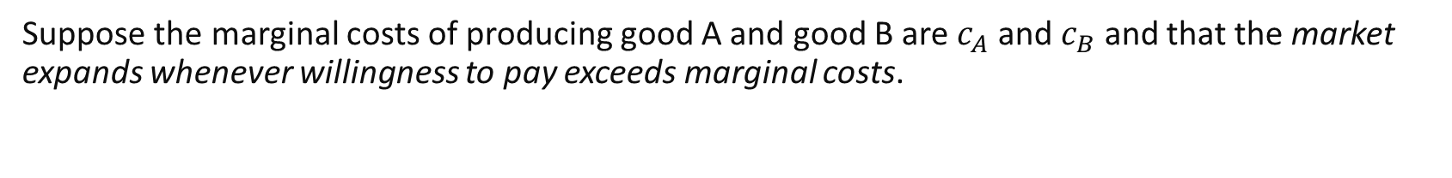

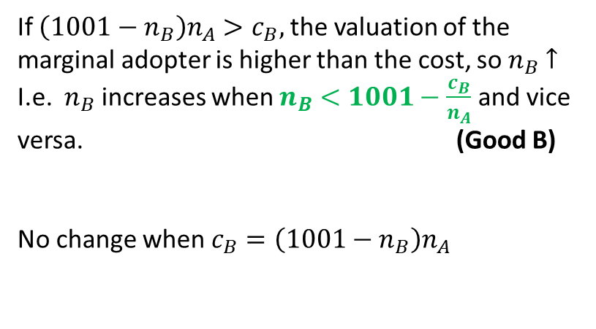

Two-sided markets
Suppose the marginal costs of producing good A and good B are $c_{A}$ and $c_{B}$ and that the market expands whenever willingness to pay exceeds marginal costs.
$$n_{B}$$
If $\left(1001−n_{B}\right)n_{A}>c_{B},$ the valuation of the marginal adopter is higher than the cost, so $n_{B}$ $↑$
I.e. $n_{B}$ increases when $n_{B}<1001−\frac{c_{B}}{n_{A}}$ and vice versa. (Good B)
No change when $c_{B}=\left(1001−n_{B}\right)n_{A}$
$$n_{B}=1001−\frac{c_{B}}{n_{A}}$$
$$n_{B}>1001−\frac{c_{B}}{n_{A}}$$
$$n_{B}<1001−\frac{c_{B}}{n_{A}}$$
$$n_{A}$$

Slide 8
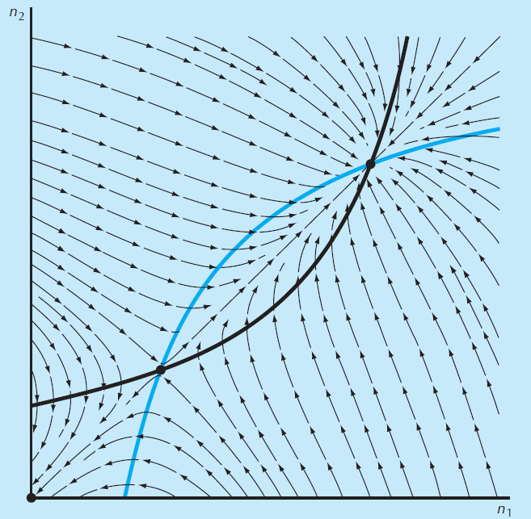


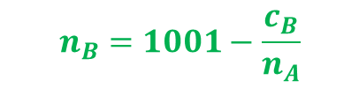
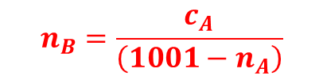

Two-sided markets
$$n_{B}=\frac{c_{A}}{\left(1001−n_{A}\right)}$$
$$n_{B}$$
Combining the two plots together..
$$n_{B}=1001−\frac{c_{B}}{n_{A}}$$
$$n_{A}$$

Slide 9
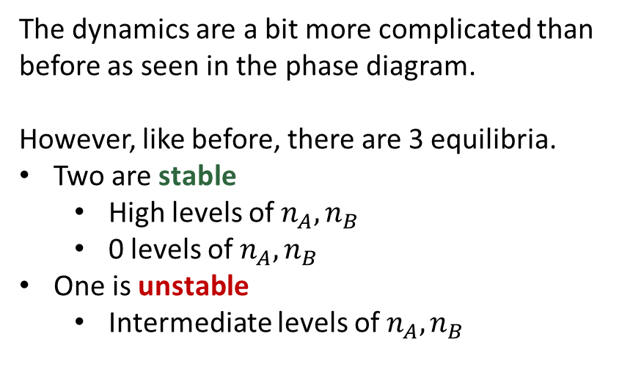

Two-sided markets: Equilibria
$$n_{B}$$
The dynamics are a bit more complicated than before as seen in the phase diagram.
However, like before, there are 3 equilibria.
Two are stable
High levels of $n_{A},n_{B}$
0 levels of $n_{A},n_{B}$
One is unstable
Intermediate levels of $n_{A},n_{B}$
$$n_{A}$$

Slide 10
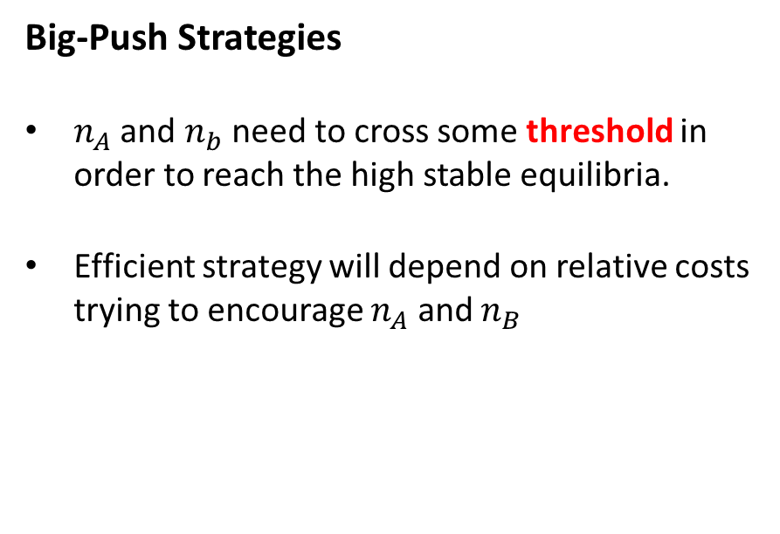
Two-sided markets: Strategies
$$n_{B}$$
Big-Push Strategies
$n_{A}$ and $n_{b}$ need to cross some threshold in order to reach the high stable equilibria.
Efficient strategy will depend on relative costs trying to encourage $n_{A}$ and $n_{B}$
$$n_{A}$$

Slide 11

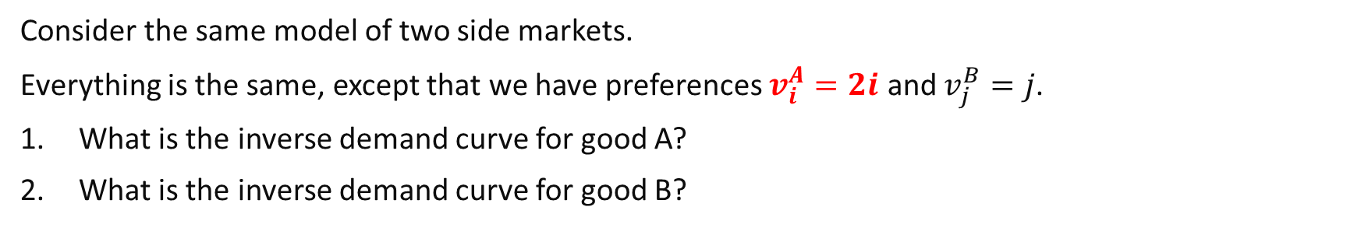
Review Questions 1
Consider the same model of two side markets.
Everything is the same, except that we have preferences $v_{i}^{A}=2i$ and $v_{j}^{B}=j$.
What is the inverse demand curve for good A?
What is the inverse demand curve for good B?
D
A
3. Select all points where if we start from them, the high stable equilibrium be reached.
B
C

Slide 12
Information Technology: Forms of Competition

Slide 13
Competition with Information Technology
With the advent of information technology, and its special characteristics, its goods are often associated with unique forms of competition compared to standard goods.
For example:
IT components often work together in systems due to complementarities.
Digital products are scalable easily at low cost and can be easily shared.
Software encryption means that it is possible to exclude individuals easily.
Consumption does not imply owning the good physically or even digitally
We will be looking at consequences of this in several simple models.

Slide 14
Competition with Switching Costs

Slide 15
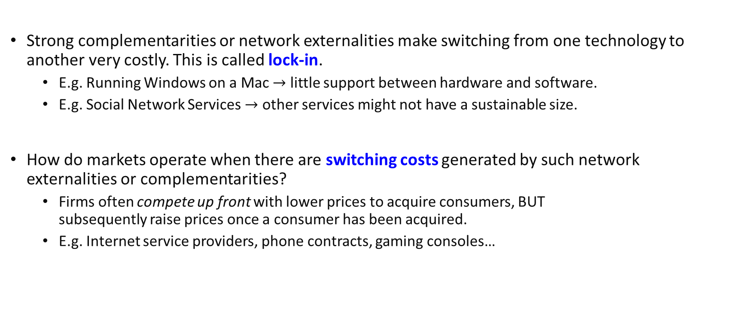
Lock-In
Strong complementarities or network externalities make switching from one technology to another very costly. This is called lock-in.
E.g. Running Windows on a Mac $→$ little support between hardware and software.
E.g. Social Network Services $→$ other services might not have a sustainable size.
How do markets operate when there are switching costs generated by such network externalities or complementarities?
Firms often compete up front with lower prices to acquire consumers, BUT subsequently raise prices once a consumer has been acquired.
E.g. Internet service providers, phone contracts, gaming consoles…
Notes:
If already at a high equilibria, difficult to unilaterally switch to a different service where no one is on.

Slide 16
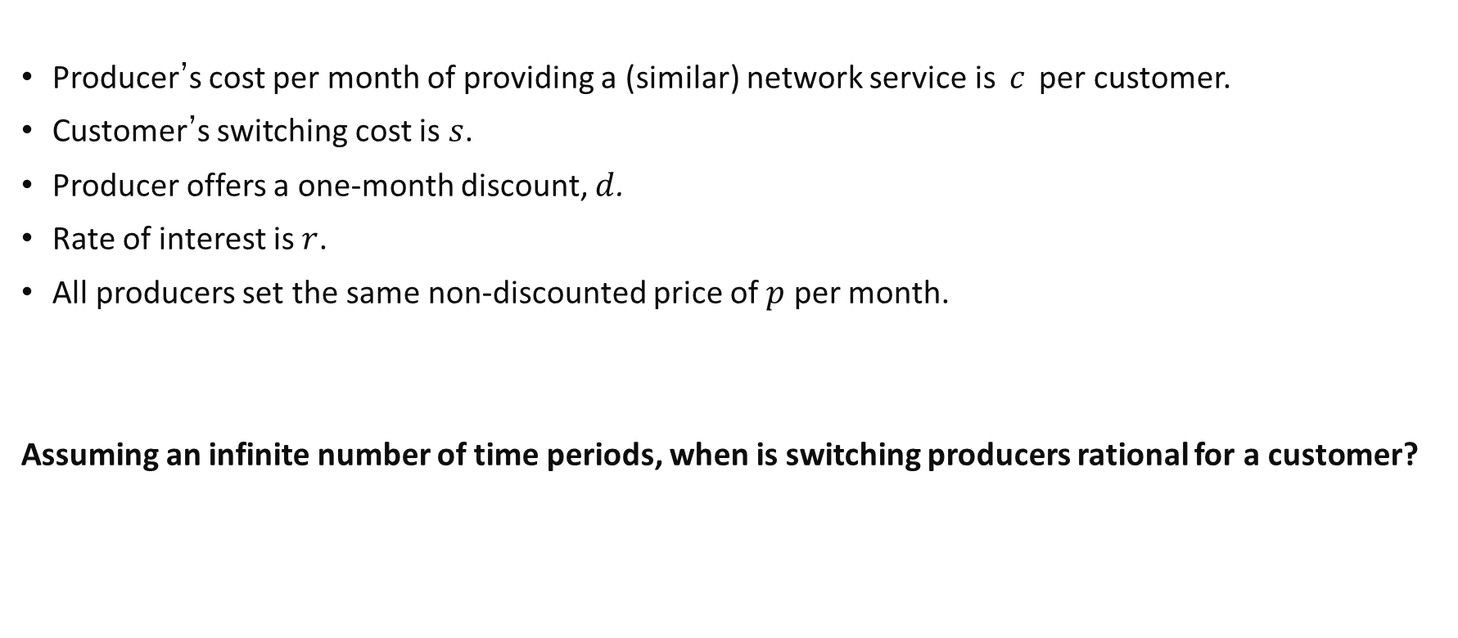
Competition & Switching Costs
Producer’s cost per month of providing a (similar) network service is $c$ per customer.
Customer’s switching cost is $s$.
Producer offers a one-month discount, $d$.
Rate of interest is $r$.
All producers set the same non-discounted price of $p$ per month.
Assuming an infinite number of time periods, when is switching producers rational for a customer?

Slide 17
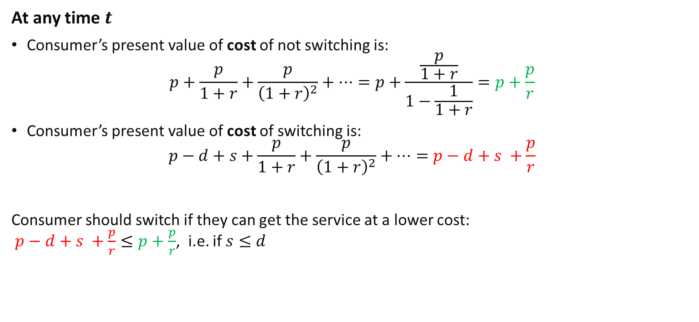
Competition & Switching Costs
Sum to infinity for geometric progression.
At any time $t$
Consumer’s present value of cost of not switching is:
$$p+\frac{p}{1+r}+\frac{p}{{\left(1+r\right)}^{2}}+…=p+\frac{\frac{p}{1+r}}{1−\frac{1}{1+r}}=p+\frac{p}{r}$$
Consumer’s present value of cost of switching is:
$$p−d+s+\frac{p}{1+r}+\frac{p}{{\left(1+r\right)}^{2}}+…=p−d+s +\frac{p}{r}$$
Consumer should switch if they can get the service at a lower cost: $p−d+s +\frac{p}{r}≤p+\frac{p}{r}$, i.e. if $s≤d$
Notes:
Remember the formula for the sum to infinity?

Slide 18
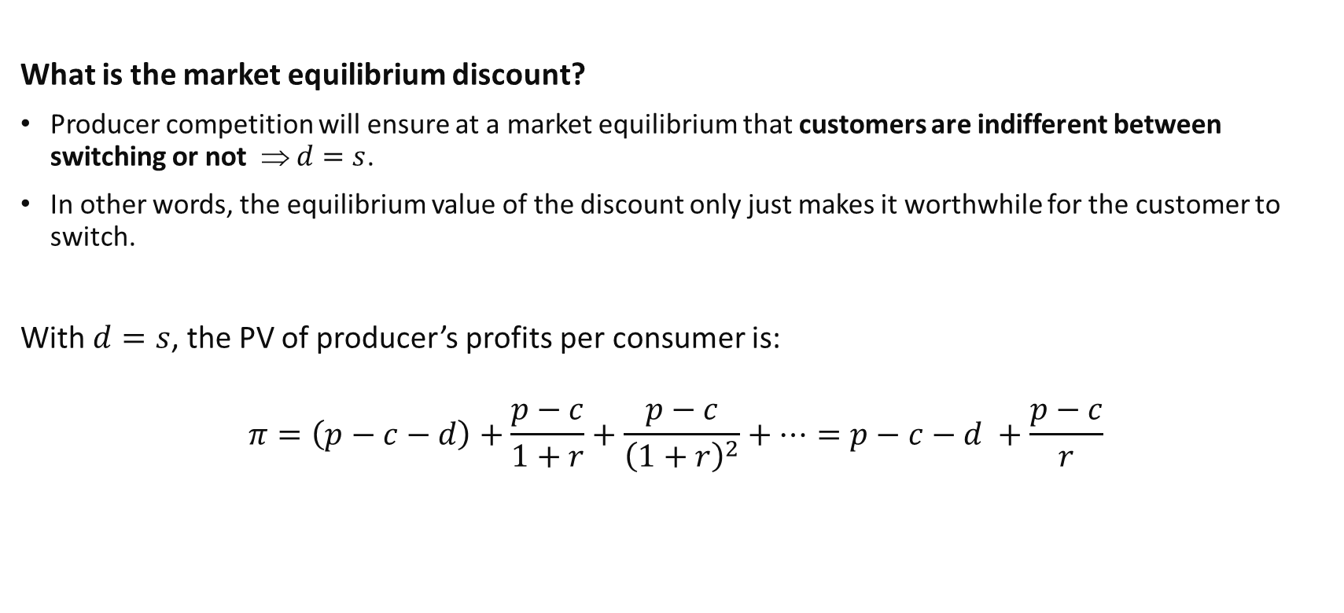
Competition & Switching Costs
What is the market equilibrium discount?
Producer competition will ensure at a market equilibrium that customers are indifferent between switching or not ⇒ $d=s$.
In other words, the equilibrium value of the discount only just makes it worthwhile for the customer to switch.
With $d=s$, the PV of producer’s profits per consumer is:
$$π=\left(p−c−d\right)+\frac{p−c}{1+r}+\frac{p−c}{{\left(1+r\right)}^{2}}+…=p−c−d +\frac{p−c}{r}$$
Notes:
If $s<d$, then will attract consumers to switch. Set the lowest d such that it occurs.
If $s>d$, then cannot attract consumers, will want to raise discount.
$$1−\frac{1}{1+r}=\frac{r}{1+r}$$

Slide 19
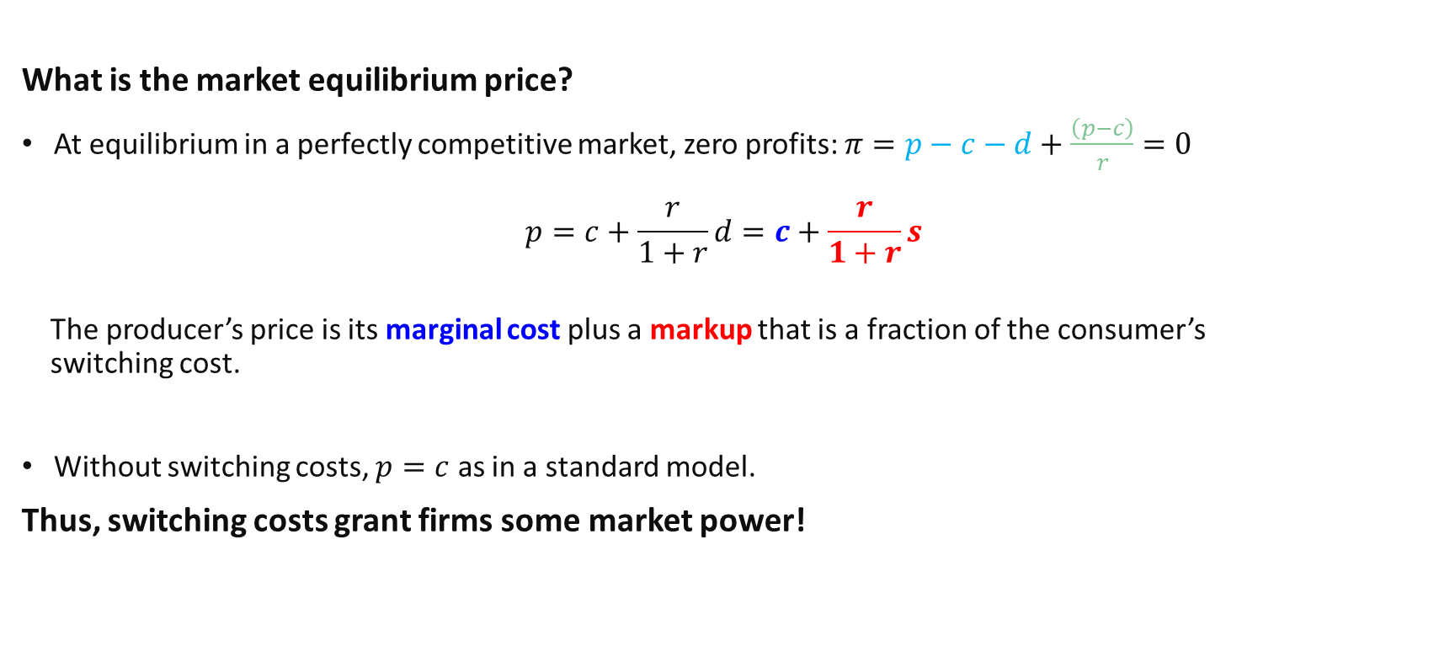
Competition & Switching Costs
What is the market equilibrium price?
At equilibrium in a perfectly competitive market, zero profits: $π=p−c−d+\frac{\left(p−c\right)}{r}=0$
$$p=c+\frac{r}{1+r}d=c+\frac{r}{1+r}s$$
The producer’s price is its marginal cost plus a markup that is a fraction of the consumer’s switching cost.
Without switching costs, $p=c$ as in a standard model.
Thus, switching costs grant firms some market power!
First period profit
Present value of subsequent periods’ profits
Notes:
P(r+1)/r = d + c/r

Slide 20
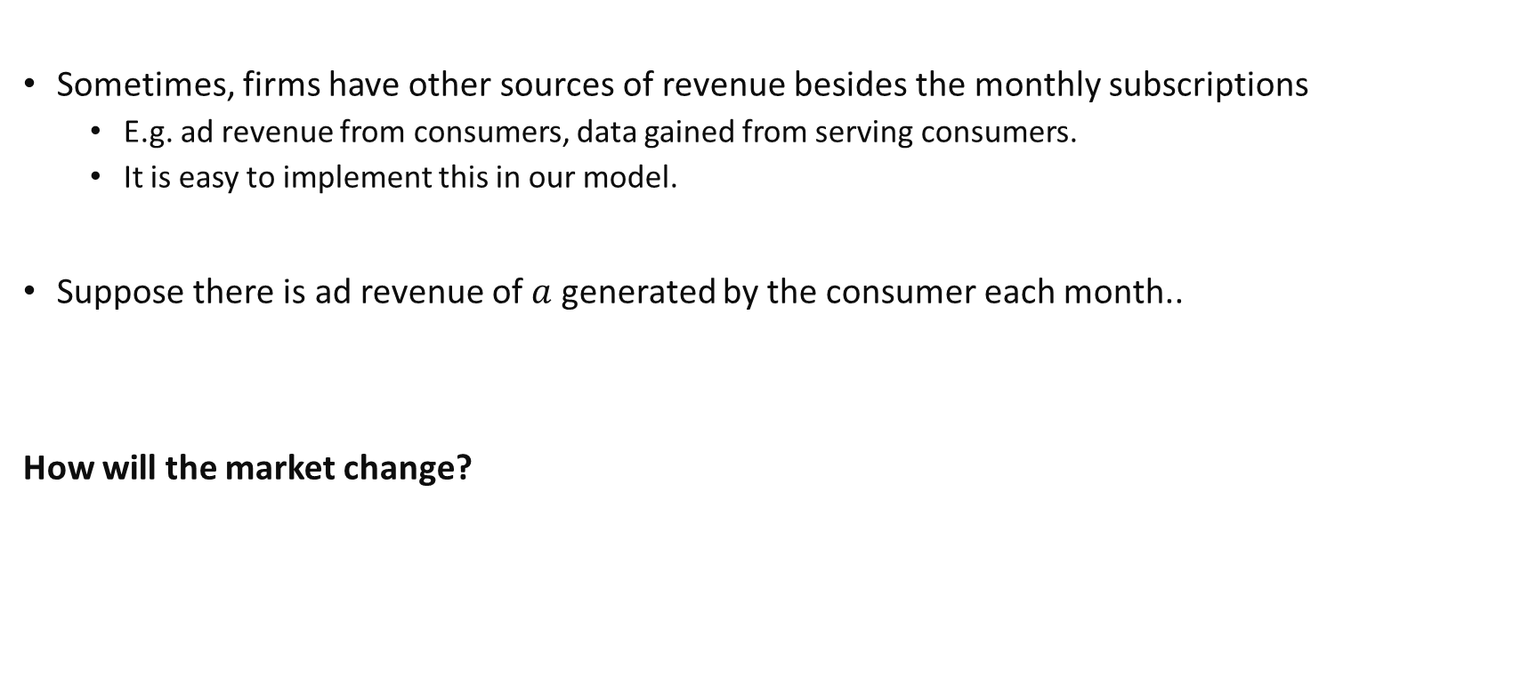
Competition & Switching Costs
Sometimes, firms have other sources of revenue besides the monthly subscriptions
E.g. ad revenue from consumers, data gained from serving consumers.
It is easy to implement this in our model.
Suppose there is ad revenue of $a$ generated by the consumer each month..
How will the market change?

Slide 21
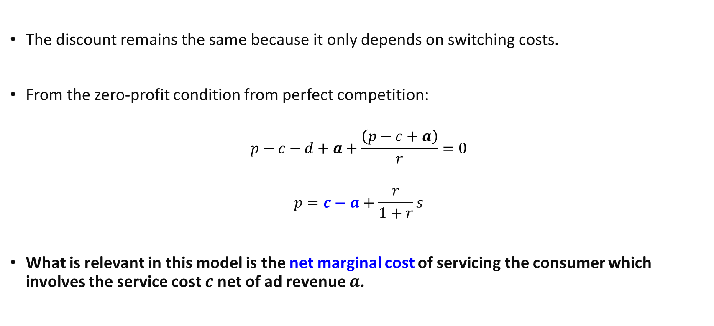
Competition & Switching Costs
The discount remains the same because it only depends on switching costs.
From the zero-profit condition from perfect competition:
$$p−c−d+a+\frac{\left(p−c+a\right)}{r}=0$$
$$p=c−a+\frac{r}{1+r}s$$
What is relevant in this model is the net marginal cost of servicing the consumer which involves the service cost $c$net of ad revenue $a$.

Slide 22
Review Questions 2
Consider the same model of switching costs.
Are the following statements True or False?
Higher switching costs increases the gap between the first month’s price and subsequent months’ prices. True
Additional sources of monthly revenue raise prices. False

Slide 23
Network externalities & Switching Costs
Let us think (informally) about some implications of network externalities in this model..
If consumers get higher utility from others purchasing from the same producer, plausible to think that switching costs will rise.
As more consumers’ purchase from the same producer, prices in the market will change.
Subsequent prices will rise, and this will be associated with a larger upfront discount.
Related to trial periods and rises in subscription costs?
Notes:
P(r+1)/r = d + c/r

Slide 24
Network externalities & Switching Costs
Let us think (informally) about some implications of network externalities in this model..
Sometimes, there may also be network externalities for the producer: e.g. per-user monthly revenue increases with more users.
As more consumers purchase from the same producer, net marginal costs will fall.
This might counter the rise in prices from higher switching costs.
For example, many social networks services remain free despite the large switching costs. Data and Ads provide large benefits for them? Perhaps they should be paying us money!
Notes:
P(r+1)/r = d + c/r

Slide 25
Intellectual Property

Slide 26
Intellectual Property
New business models involving digital goods often involve intellectual property.
“Intellectual property (IP) refers to creations of the mind, such as inventions; literary and artistic works; designs; and symbols, names and images used in commerce”
Not only are goods sold outright, there are also transactions involving intellectual property:
Should one use copy protection for one’s goods?
Rights for distribution on subscription services.(Digital books, Movies, Music…)
Businesses thus need to carefully consider how they make decisions with regards to how they offer their goods.

Slide 27
Intellectual Property
In what follows, we will examine one way in which firms with (digital) intellectual property may decide to organise their business process: Intellectual Property sharing.
As in many models, the assumptions are reasonable but somewhat restrictive…
You should treat them as “toy models” which illustrate how to model and perform similar analysis for these kinds of markets.
Main learning outcomes: 1) How to translate market characteristics into assumptions in a model. 2) Solving the model and using it to make predictions. The tutorial will have other simple examples..

Slide 28
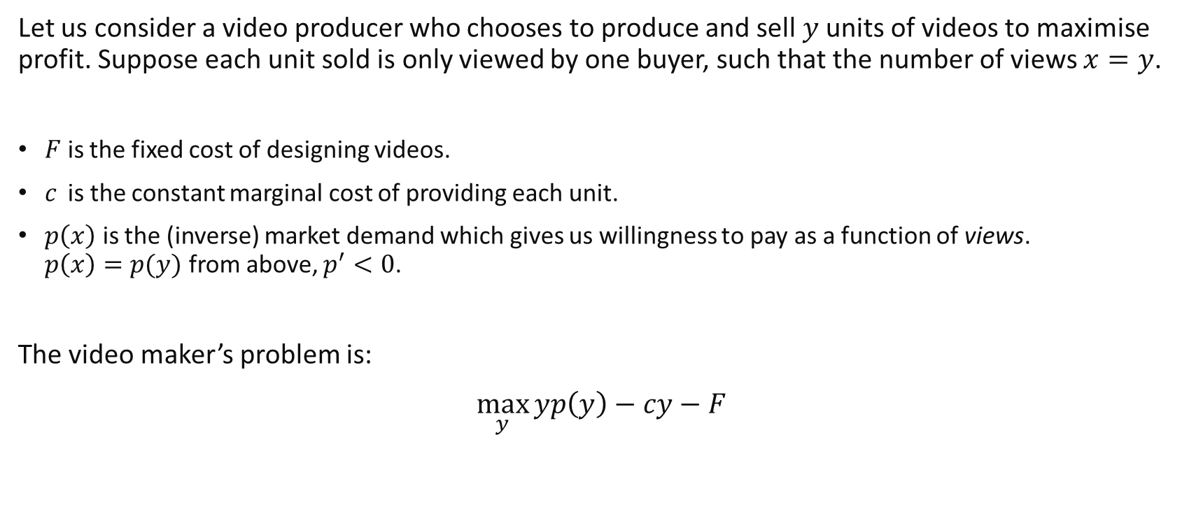
Sharing Intellectual Property
Let us consider a video producer who chooses to produce and sell $y$ units of videos to maximise profit. Suppose each unit sold is only viewed by one buyer, such that the number of views $x=y$.
$F$ is the fixed cost of designing videos.
$c$ is the constant marginal cost of providing each unit.
$p\left(x\right)$ is the (inverse) market demand which gives us willingness to pay as a function of views. $p\left(x\right)=p(y)$ from above, $p^{′}<0$.
The video maker’s problem is:
$$\max_{y}{yp\left(y\right)−cy−F}$$
Notes:
The more views of the video, the lower the willingness to pay of the marginal individual.

Slide 29

Sharing Intellectual Property
The FOC for the profit maximising problem is:
$$yp^{′}\left(y\right)+p\left(y\right)−c=0$$
The above defines an implicit function for the optimal $y^{∗}$ as a function of $c$: $y^{∗}(c)$
An implicit equation is given by say $g\left(x,y,z\right)=0.$ This implies that there we can write a function of $x$ in terms of $y,z$, which is an implicit function.

Slide 30
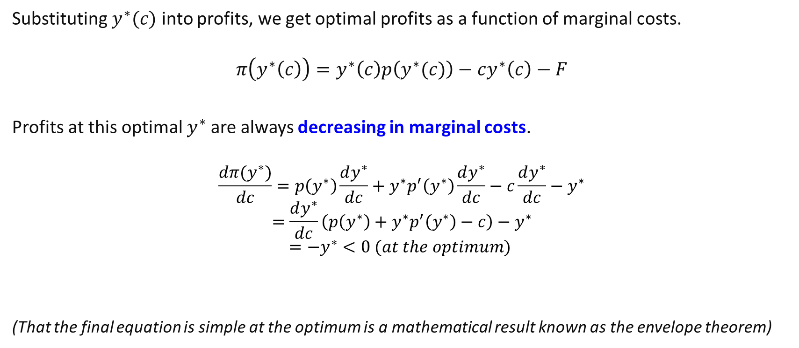
Sharing Intellectual Property
Substituting $y^{∗}(c)$ into profits, we get optimal profits as a function of marginal costs.
$$π\left(y^{∗}\left(c\right)\right)=y^{∗}\left(c\right)p\left(y^{∗}(c)\right)−cy^{∗}\left(c\right)−F$$
Profits at this optimal $y^{∗}$are always decreasing in marginal costs.
$$\frac{dπ(y^{∗})}{dc}=p\left(y^{∗}\right)\frac{dy^{∗}}{dc}+y^{∗}p^{′}\left(y^{∗}\right)\frac{dy^{∗}}{dc}−c\frac{dy^{∗}}{dc}−y^{∗}$$
$$=\frac{dy^{∗}}{dc}\left(p\left(y^{∗}\right)+y^{∗}p^{′}\left(y^{∗}\right)−c\right)−y^{∗}$$
$$=−y^{∗}<0 (at the optimum)$$
(That the final equation is simple at the optimum is a mathematical result known as the envelope theorem)

Slide 31
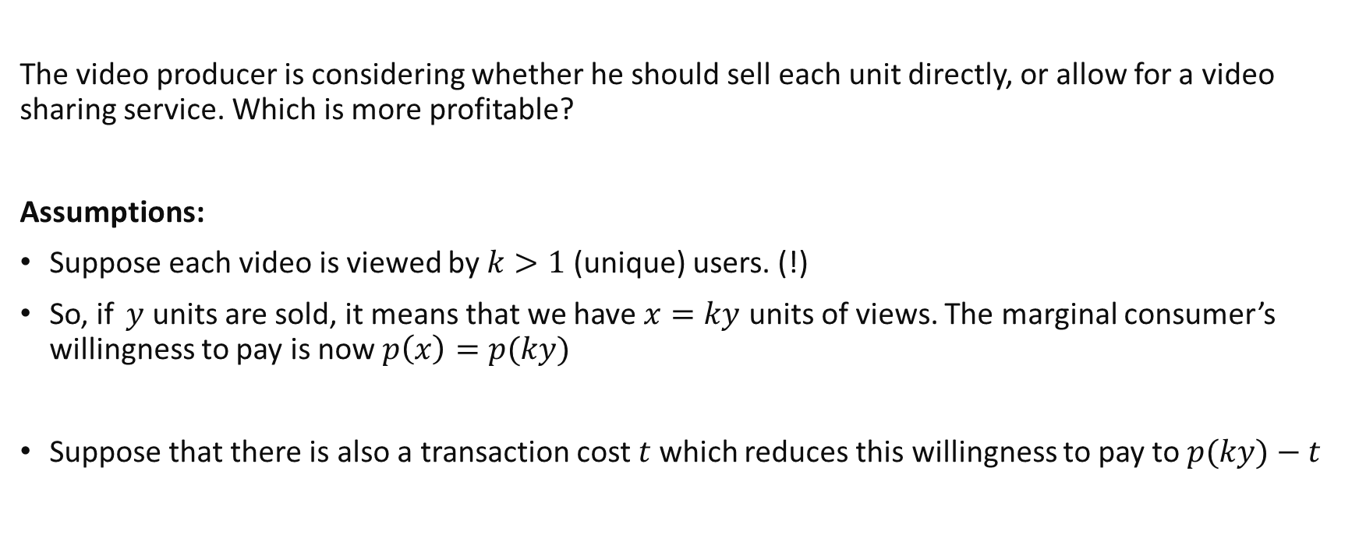
Sharing Intellectual Property
The video producer is considering whether he should sell each unit directly, or allow for a video sharing service. Which is more profitable?
Assumptions:
Suppose each video is viewed by $k>1$(unique) users. (!)
So, if $y$ units are sold, it means that we have $x=ky$ units of views. The marginal consumer’s willingness to pay is now $p\left(x\right)=p(ky)$
Suppose that there is also a transaction cost $t$ which reduces this willingness to pay to $p(ky)−t$
Notes:
(if there is not unique sharing one way to model it is as $αk$, $k<1$)

Slide 32
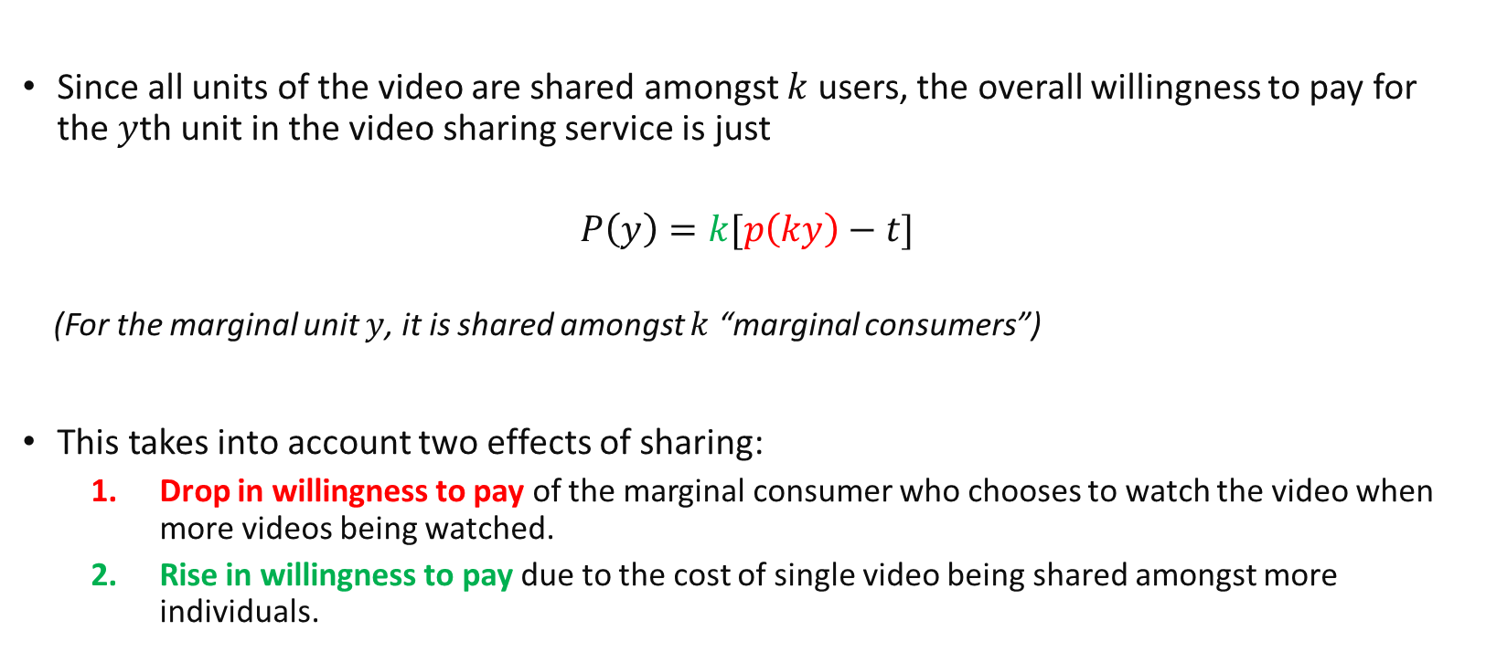
Sharing Intellectual Property
Since all units of the video are shared amongst $k$ users, the overall willingness to pay for the $y$th unit in the video sharing service is just
$$P\left(y\right)=k[p\left(ky\right)−t]$$
(For the marginal unit $y$, it is shared amongst $k$ “marginal consumers”)
This takes into account two effects of sharing:
Drop in willingness to pay of the marginal consumer who chooses to watch the video when more videos being watched.
Rise in willingness to pay due to the cost of single video being shared amongst more individuals.

Slide 33
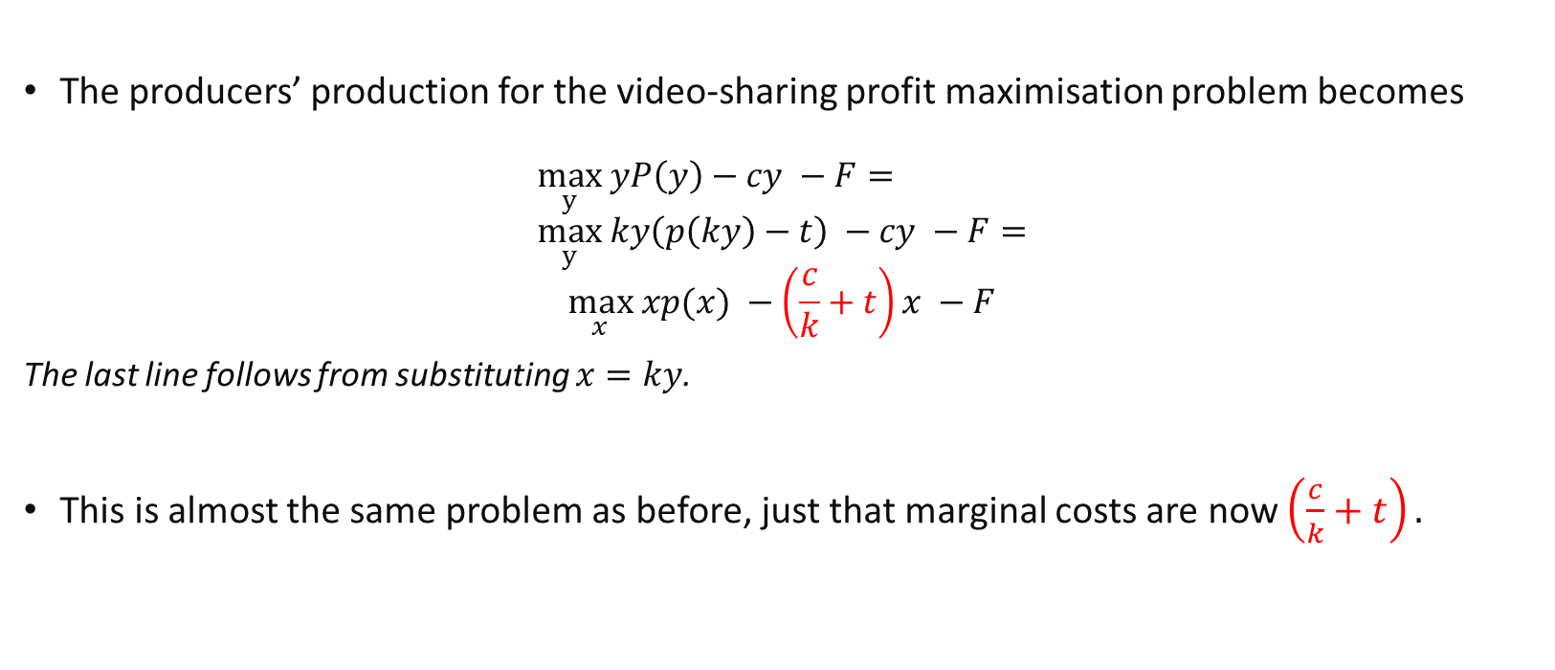
Sharing Intellectual Property
The producers’ production for the video-sharing profit maximisation problem becomes
$$\max_{y} yP\left(y\right)−cy −F= \\ \max_{y} ky\left(p\left(ky\right)−t\right) −cy −F=$$
$$\max_{x} xp(x) −\left(\frac{c}{k}+t\right)x −F$$
The last line follows from substituting $x=ky$.
This is almost the same problem as before, just that marginal costs are now $\left(\frac{c}{k}+t\right).$

Slide 34
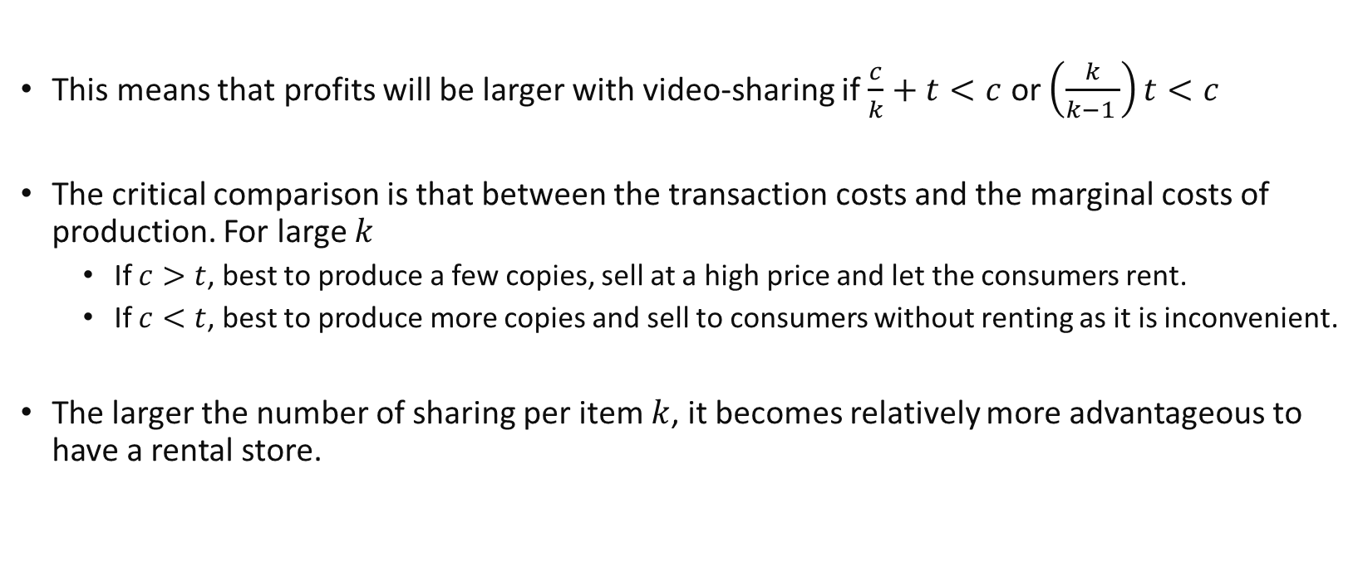
Sharing Intellectual Property
This means that profits will be larger with video-sharing if $\frac{c}{k}+t<c$ or $\left(\frac{k}{k−1 }\right)t<c$
The critical comparison is that between the transaction costs and the marginal costs of production. For large $k$
If $c>t$, best to produce a few copies, sell at a high price and let the consumers rent.
If $c<t$, best to produce more copies and sell to consumers without renting as it is inconvenient.
The larger the number of sharing per item $k$, it becomes relatively more advantageous to have a rental store.

Slide 35
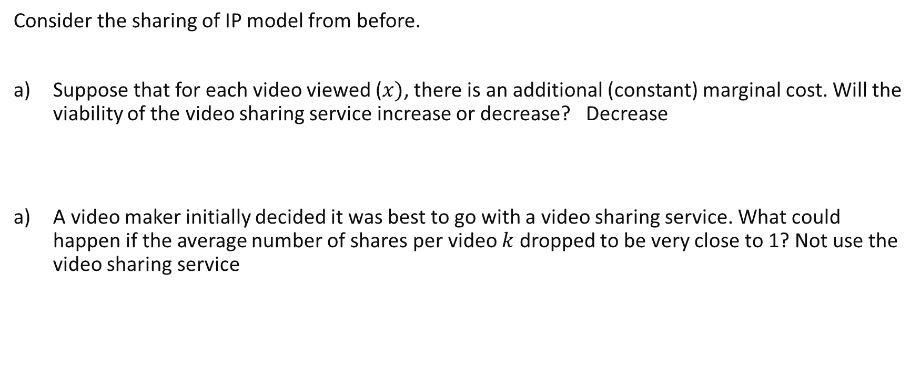
Review Questions 3
Consider the sharing of IP model from before.
Suppose that for each video viewed ($x)$, there is an additional (constant) marginal cost. Will the viability of the video sharing service increase or decrease? Decrease
A video maker initially decided it was best to go with a video sharing service. What could happen if the average number of shares per video $k$ dropped to be very close to 1? Not use the video sharing service

Slide 36
Key learning outcomes
How to solve models of network externalities in two sided markets.
Understand how to formulate different models of competition
Discounts and switching costs
Sharing intellectual property
Know how to analyse the effects of changes in exogeneous parameters in such models.

Slide 37
Readings
Varian Chapter 36

